Slide 1
IT Solutions in Alternative Care System
Armenia’s Manuk Database
Strengths and weaknesses in support to case management
December 4, 2019. Armenia Team: Aida Muradyan & Mira Antonyan
Notes:
Photo on the title page from the site visits in Vanadzor Day care center: Manuk database administrator is demonstrating how to improve the data entry to specialists of the Day care center with participation of the Heads of Divisions from MoLSA Child Related Issues and M&E, Director of the Center

Slide 2
Presenter
  Mira Antonyan
  President of Armenian Association of Social Workers
  Director of Child Support Center

Slide 3
Topics
  Overview of Armenia’s Manuk database and its use child case management
  MEASURE Evaluation support to improve data quality and use from the IT system for better case management

Slide 4
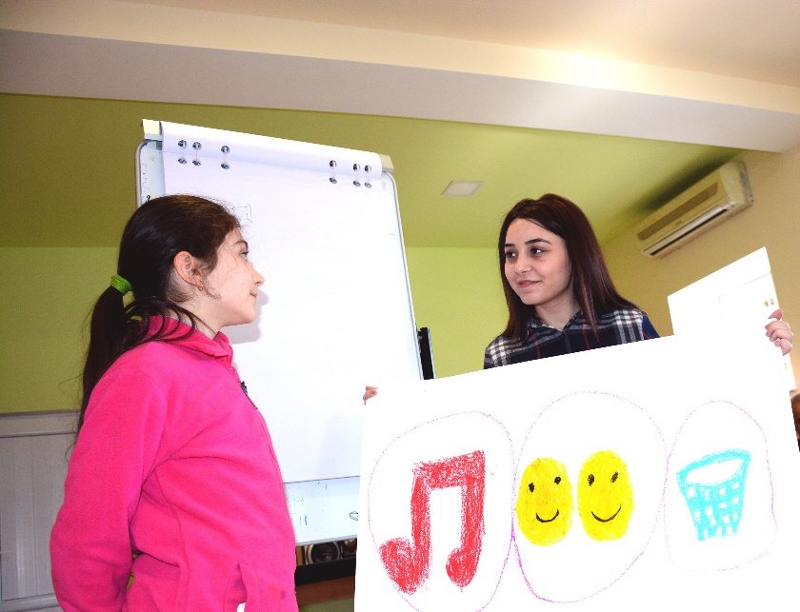
Overview of Armenia’s Manuk Information System I
  Manuk – means child in Armenian
  Established in 2003 to track children in orphanages
Notes:
With new state policy of 2007 - 16 special schools were transformed into Night care institutions and were give to MoLSA’s administration
Three-tiered CP system
EU, USAID, World Vision, and UNICEF support to strengthen data collection and reporting through national database on children in adversity
Every child who receive services has his/her casefile in paper and in Manuk database

Slide 5
Overview of Armenia’s Manuk Information System II
  National Strategy of 2004-2015: Further modifications were resulted due to the first stream of care reform
  2007 – transformation of special schools to night care institutions

Slide 6
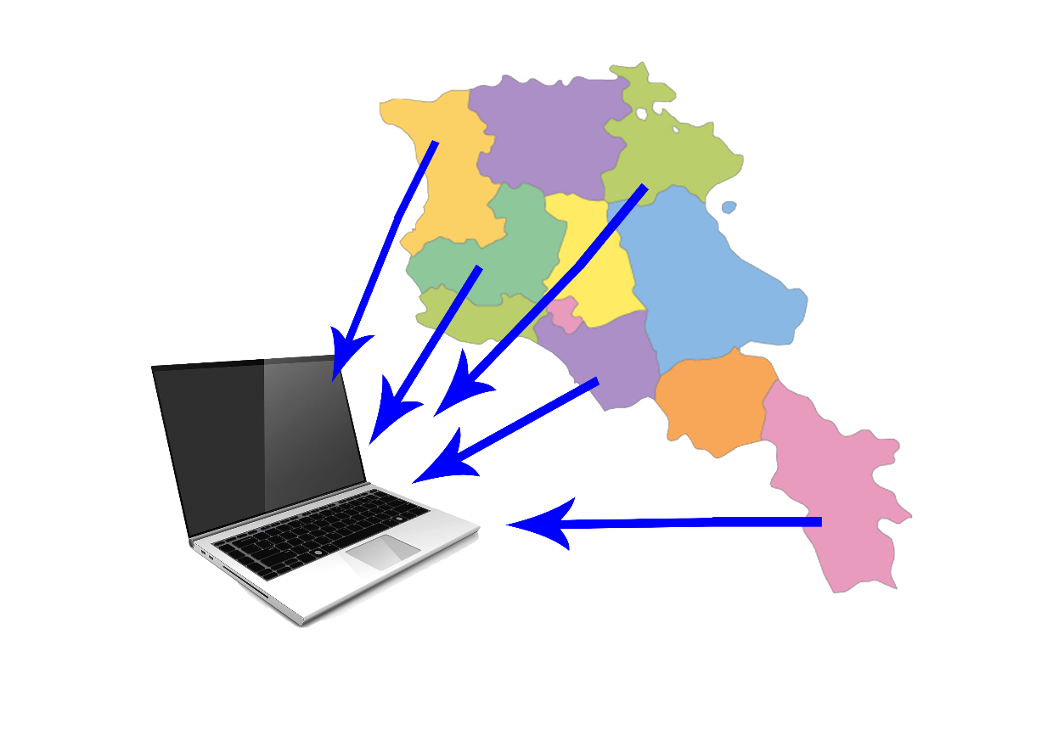
Overview of Armenia’s Manuk Information System III
  2010 – New web-based system; new interface, new platform, all regions linked, direct data entry, nationwide trainings to use database
  2013 – community level data entry

Slide 7
Statistics (1):
Total number: 8000 children
Children with the status “deprived of parental care”: 572 children ( or 7 %)

Slide 8
Statistics (2): Number of children in night care facilities and special schools

Slide 9
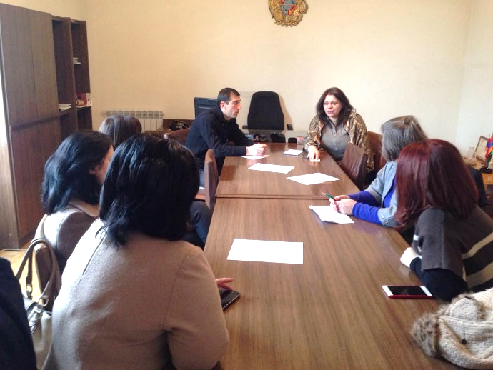
Use of Manuk IS for child case management I
  Mandatory for all type of care providers
  (state funded and private)
  Regional Child Protection units are responsible for registration of the case and referral to care institutions

Slide 10
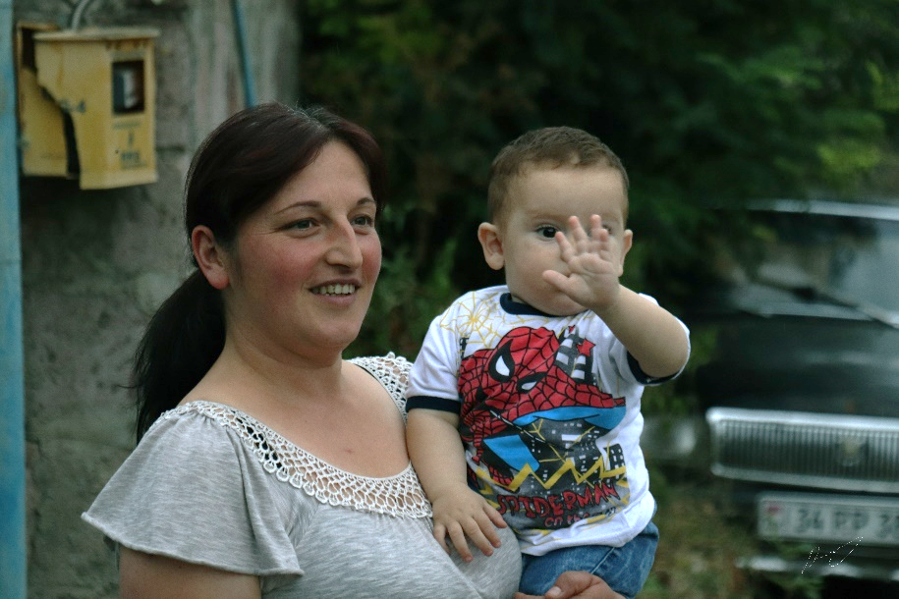
Use of Manuk IS for child case management II
Separate sections on adoption:
  PAPs registration, children ready for adoption and adoptions made

Slide 11
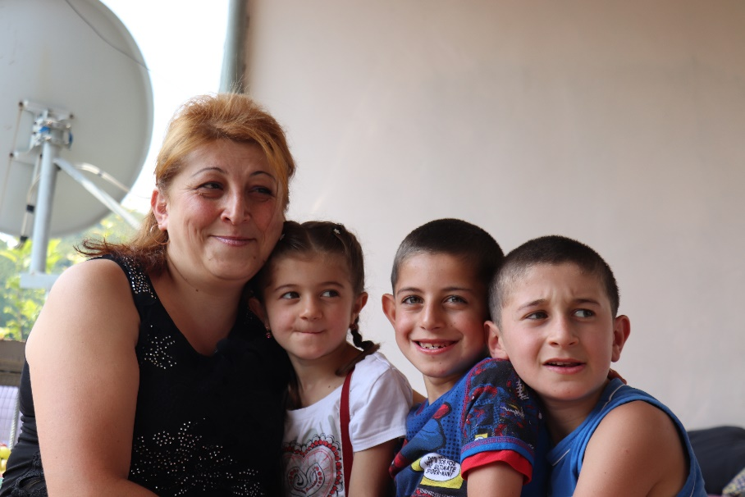
Use of Manuk IS for child case management III
Separate sections on foster care:
  Registration and training of foster parents
  Soon new module on children in foster care

Slide 12
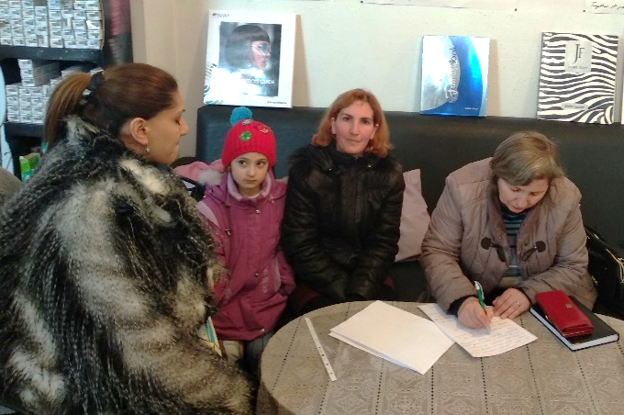
Use of Manuk database for routine monitoring
  The Ministry could generate 21 types of reports from Manuk database for their reports
  Separate monitoring data on 11 child protection programs under MoLSA’s administration

Slide 13
Challenges
  Regional data quality check visits in November and December 2018 revealed three types of issues.
Issue | Description
Technical | Poor internet, old computers, lack of technical support, poor communication, use of old reporting forms
Capacity | No training since 2013, lack of knowledge of the importance of high-quality data
Responsibility | High turnover of staff, no communication of responsibilities
Notes:
With MEASURE Evaluation support in November and December 2018 our CCT members have conducted Marz visits to regional units of Children’s Rights Protection, service providers and community social workers
We met with state on not state orphanages, state and non state day care service providers, transformed special school; small group homes;
reveal many issues that create challenges with accuracy of data entry and especially with data use.
Not regular entry of data;
Inconsistency with child case files,
Poor recording of all fields and information
Change of users
No clear understanding of reporting chains

Slide 14
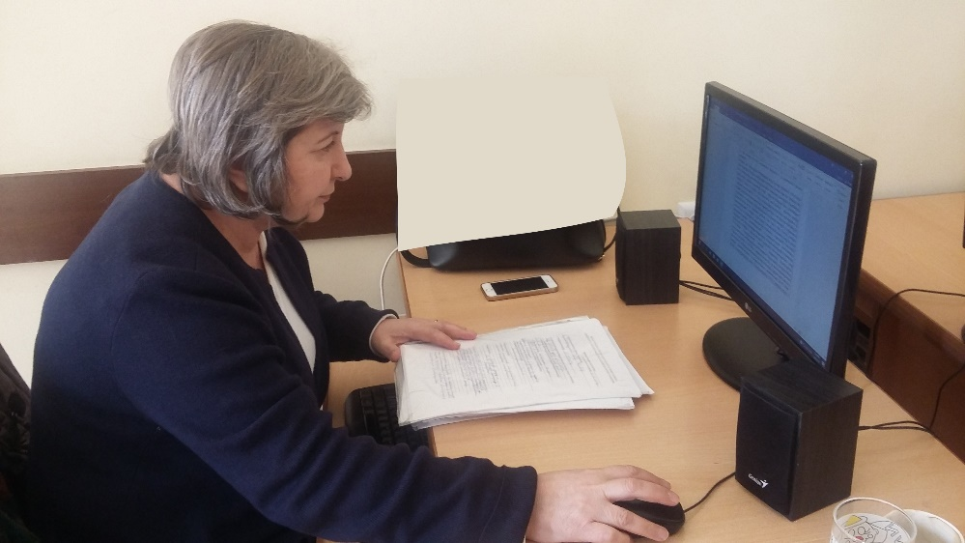
Challenges with data use I
  Almost no use of data recorded in IS - lack of knowledge and skills
  Parallel databases to generate local reports

Slide 15
Challenges with data use II
  No recording of data on prevention and family reunification services
  No skills to create charts and visualize data

Slide 16
Use of Manuk database for routine monitoring I
  Not all sectors of care reform have data to monitor
  Modifications in Manuk IS with MEASURE Evaluation support

Slide 17
Use of Manuk database for routine monitoring II
  Modified system will allow data collection on:
  Prevention
  Reunification
  Services delivery
  Monitoring visits

Slide 18
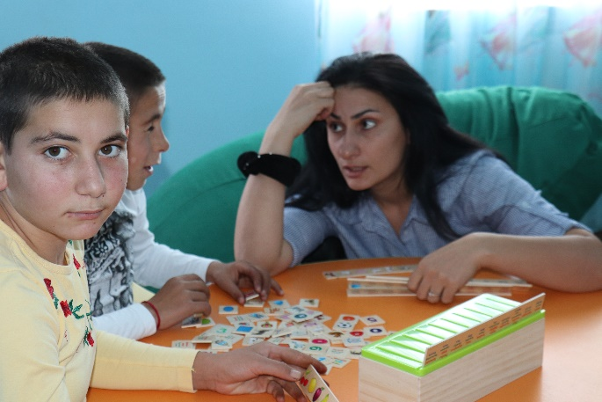
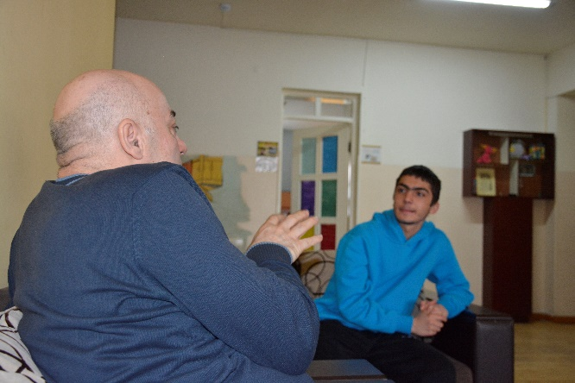
Use of Manuk database for routine monitoring III
  24 indicators on each area of care reform with MEASURE Evaluation support
  30 types of summary reports
  We expect high interest from regions to enter data and improve case management

Slide 19
Upon selection of “Child placed in alternative care” from reasons, the following list should drop down and one of the items should be selected

Slide 20
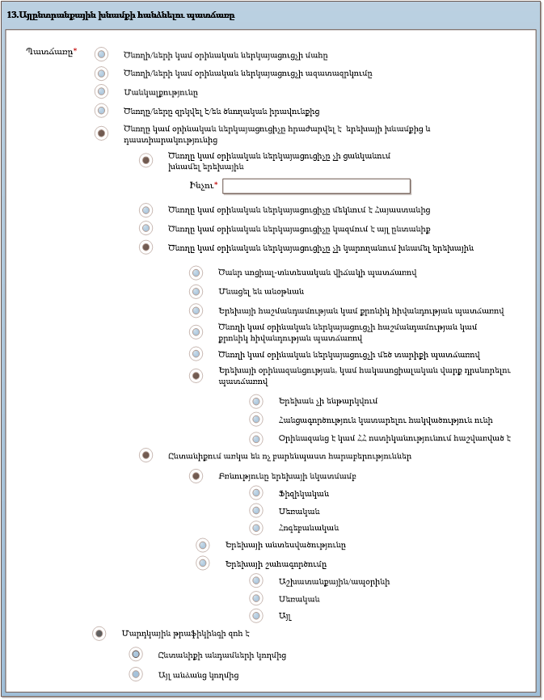
The reason for placing a child in alternative care

Slide 21
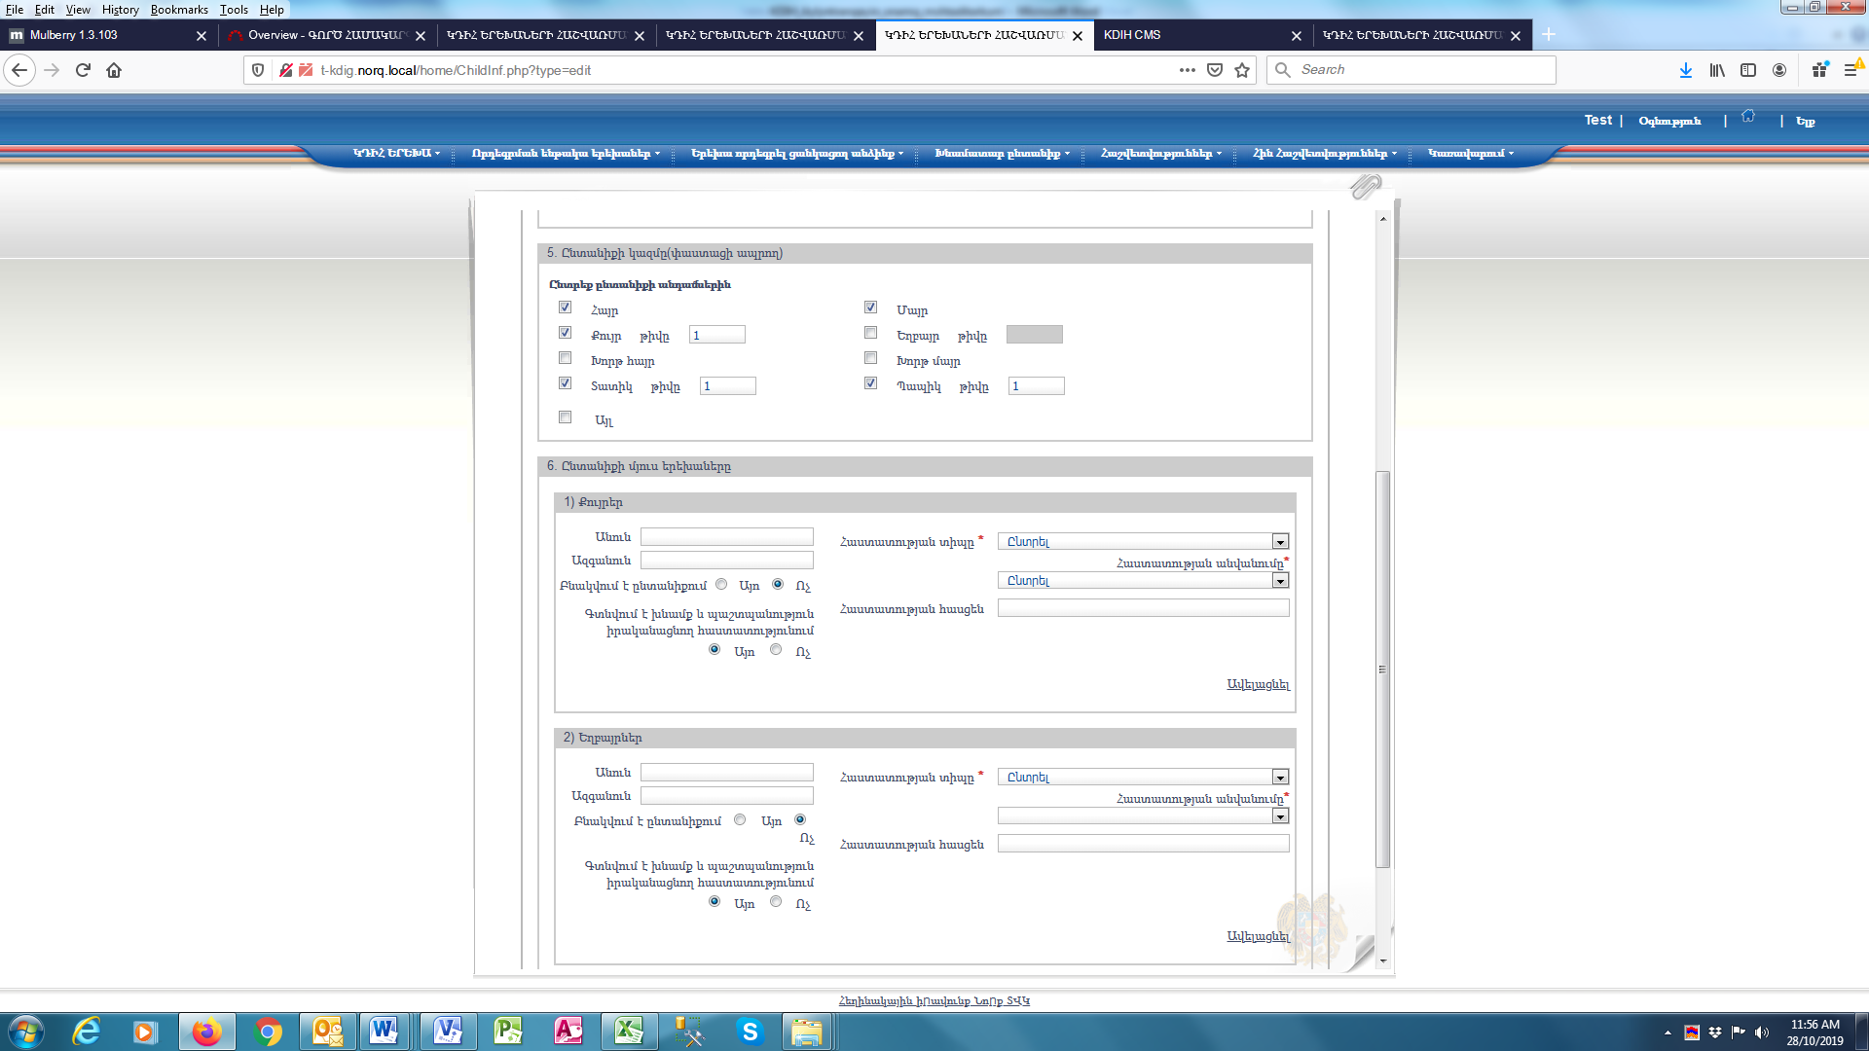
Other children of the family

Slide 22
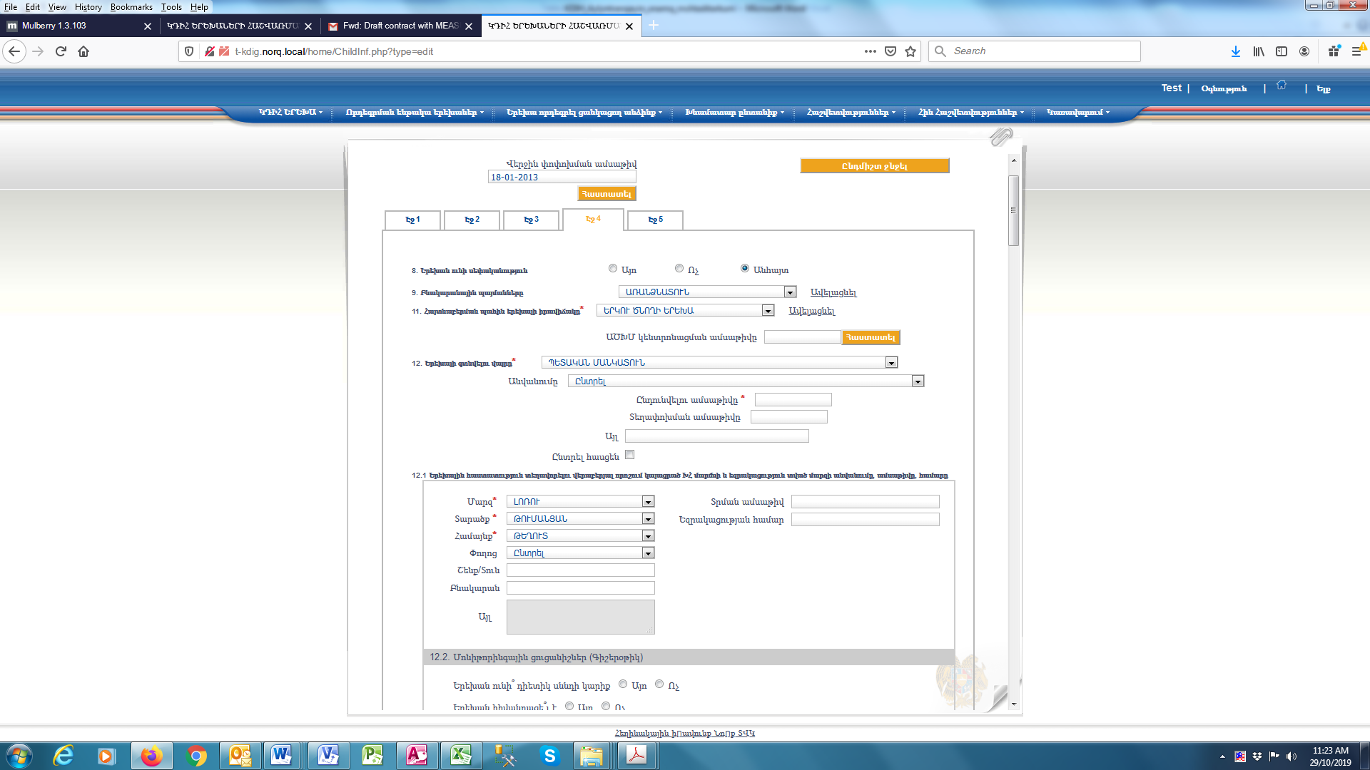
The name of the Guardianship Committee which made the decision on child placement in the institution and the name of the region provided the conclusion, the date and the number

Slide 23
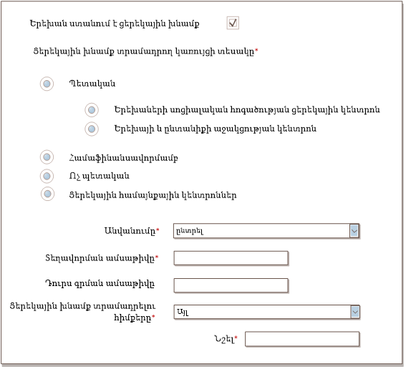
The child receives day care services

Slide 24
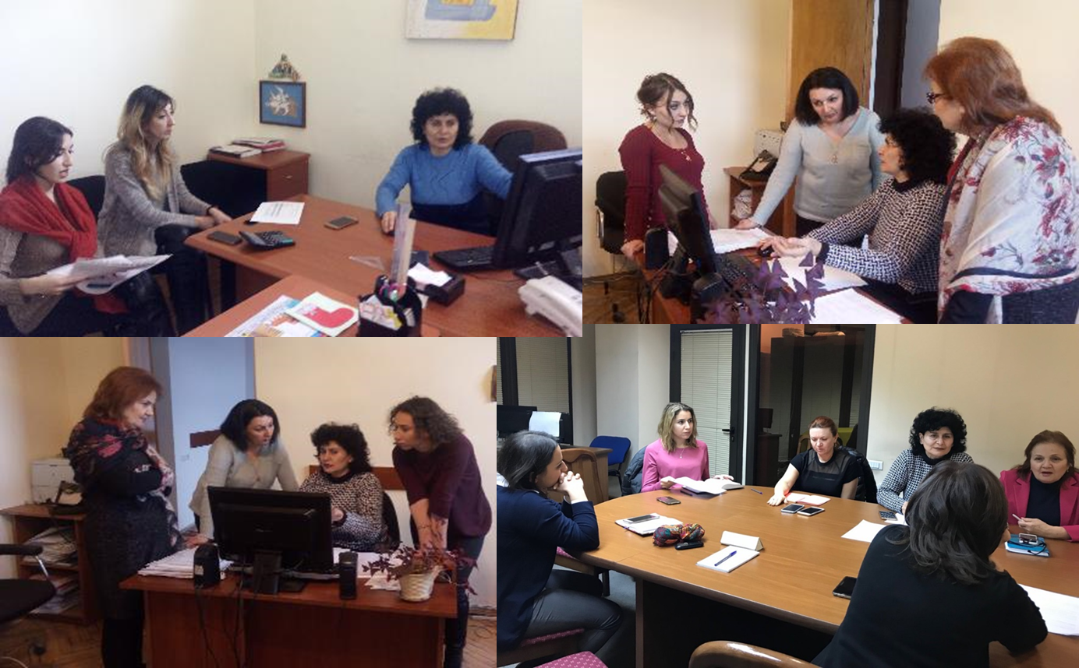

Thank you!
Mira Antonyan: antonyan.mira@gmail.com
Notes:
Photos from data quality check site visits and round table discussion on the field trip results

